Slide 1
Cse 3104 : Database Sessional
LAB-3

Slide 2
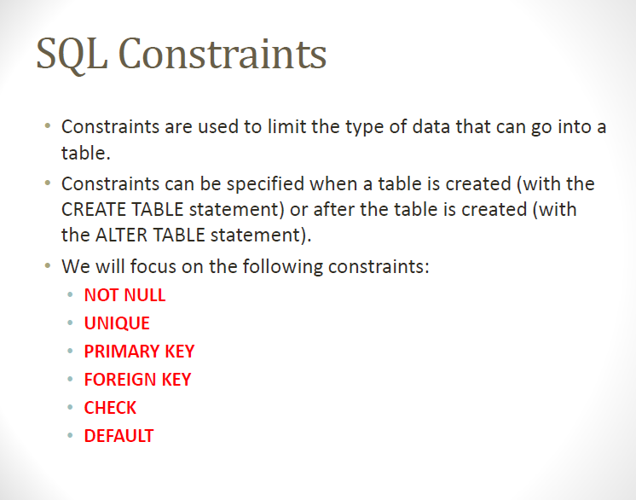

Slide 3
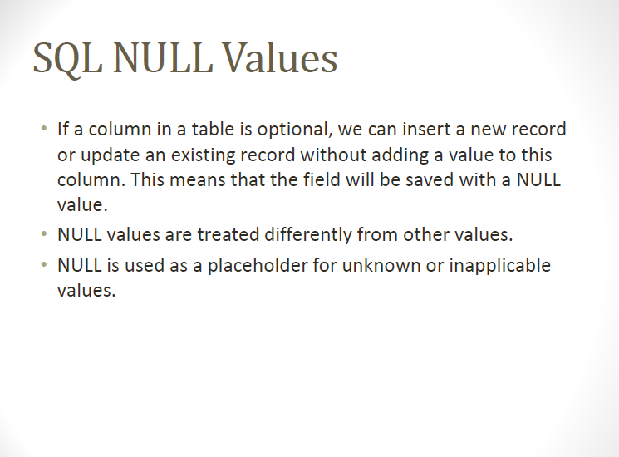

Slide 4
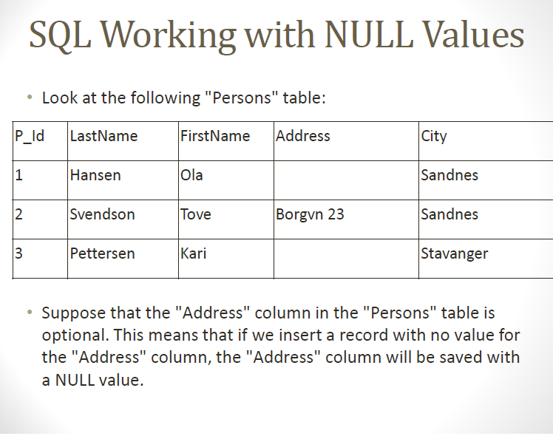

Slide 5
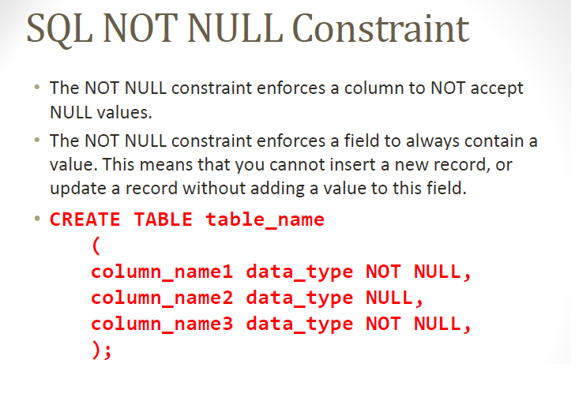

Slide 6
The following SQL enforces the "P_Id" column and the "LastName" column to not accept NULL values:
CREATE TABLE Persons
(
P_Id int NOT NULL,
LastName varchar(255) NOT NULL,
FirstName varchar(255),
Address varchar(255),
City varchar(255)
)

Slide 7
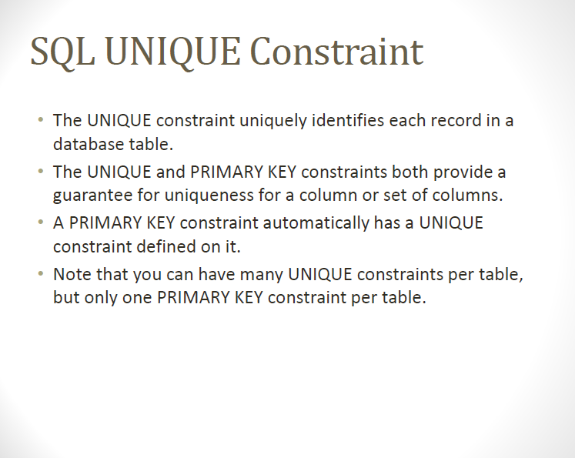

Slide 8
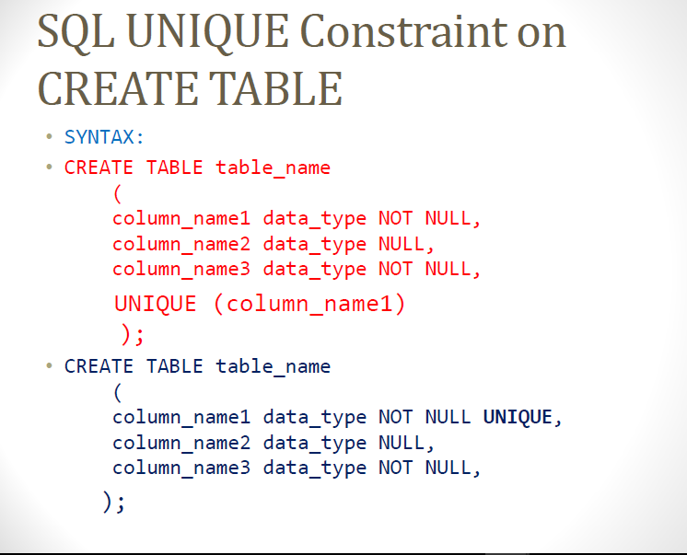

Slide 9
CREATE TABLE Persons
(
P_Id int NOT NULL UNIQUE,
LastName varchar(255) NOT NULL,
FirstName varchar(255),
Address varchar(255),
City varchar(255)
)

Slide 10
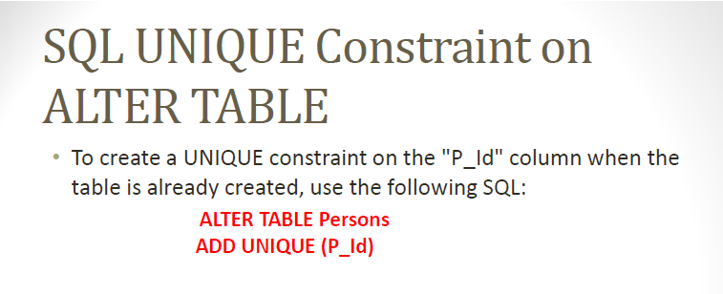

Slide 11
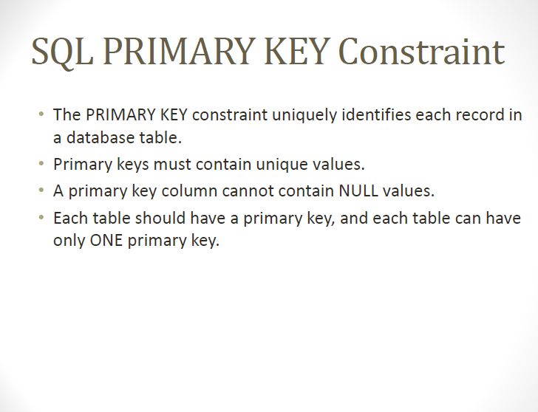

Slide 12
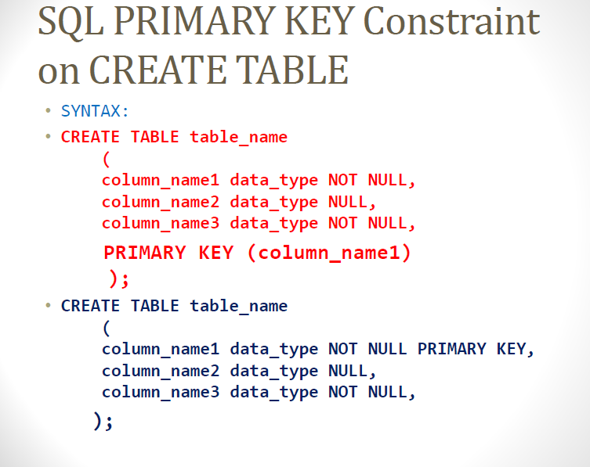

Slide 13
CREATE TABLE Persons ( P_Id int NOT NULL PRIMARY KEY, LastName varchar(255) NOT NULL, FirstName varchar(255), Address varchar(255), City varchar(255) )

Slide 14
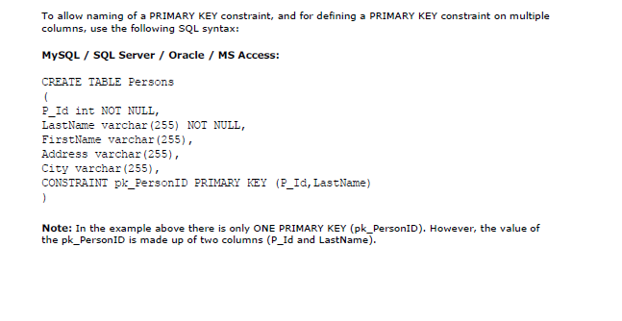

Slide 15
CREATE TABLE Persons ( P_Id int NOT NULL, LastName varchar(255) NOT NULL, FirstName varchar(255), Address varchar(255), City varchar(255), CONSTRAINT pk_PersonID PRIMARY KEY(P_Id,LastName) )

Slide 16
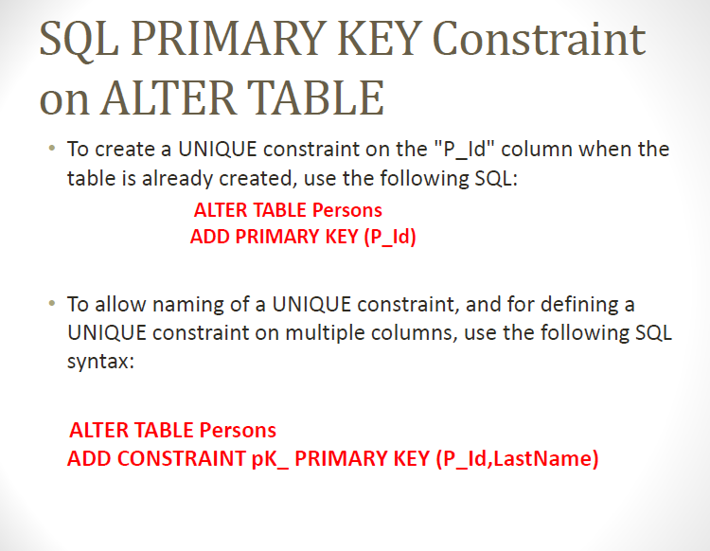

Slide 17
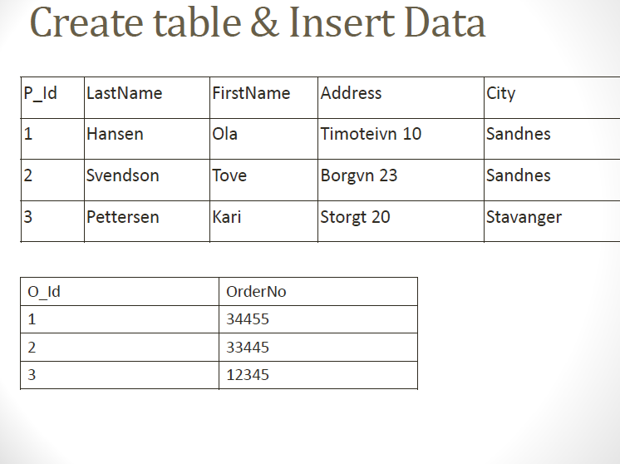

Slide 18
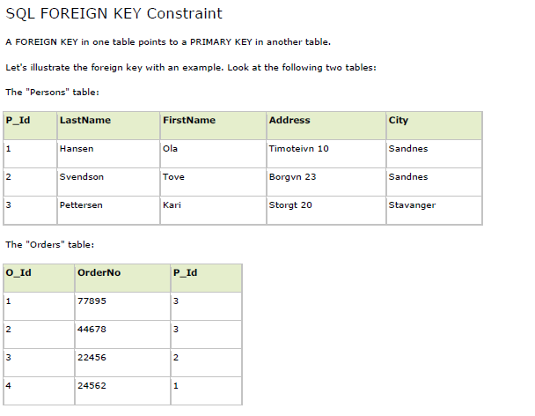

Slide 19
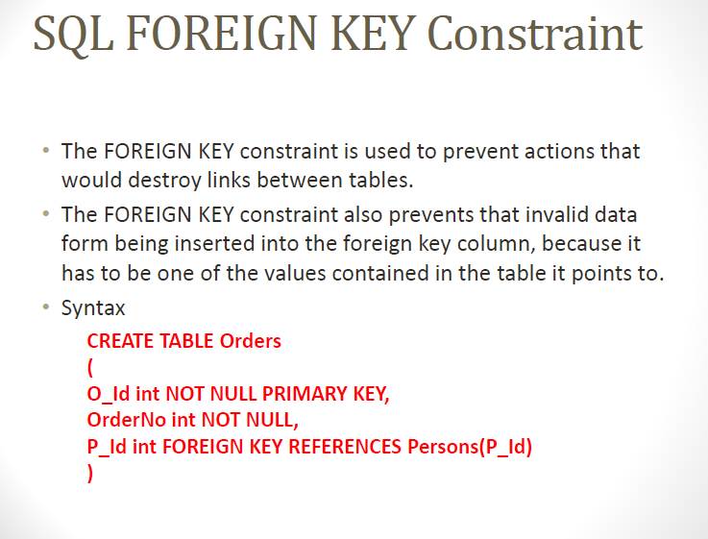

Slide 20
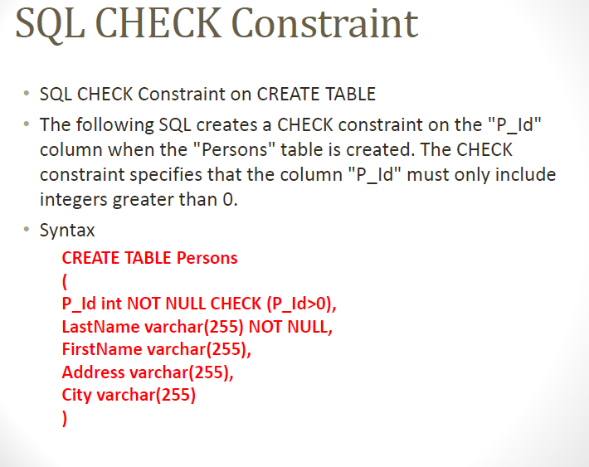

Slide 21


Slide 22
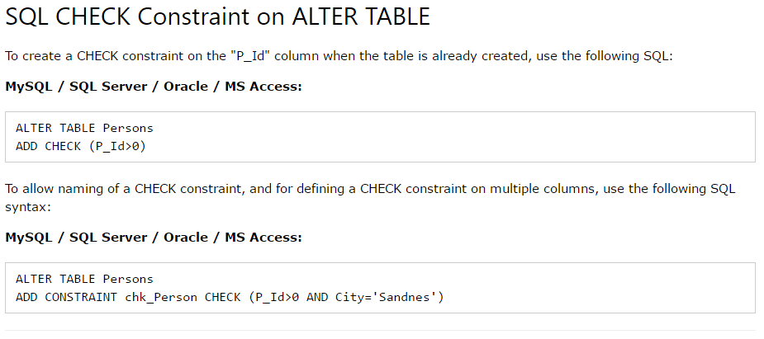

Slide 23
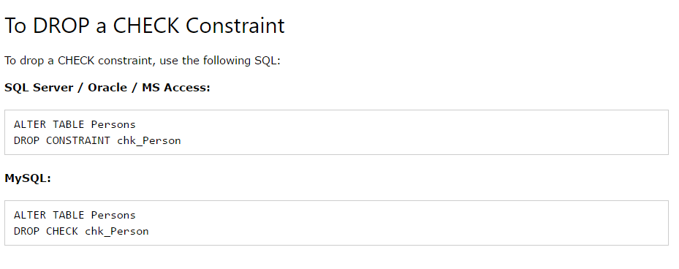

Slide 24
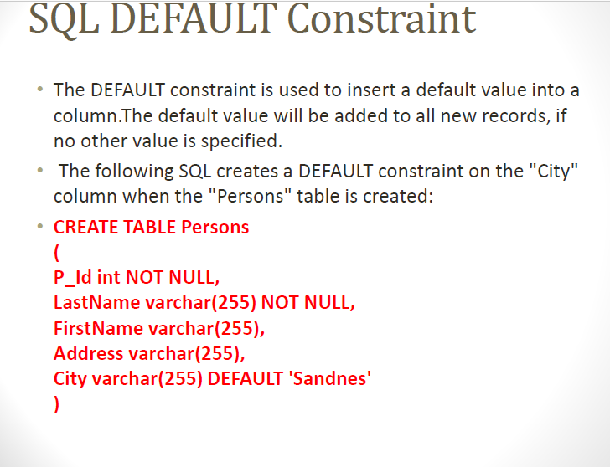

Slide 25
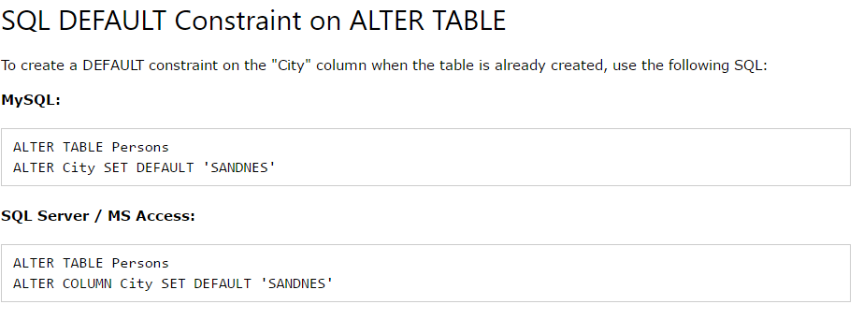

Slide 26

